Slide 1


Locked in Mecca
Blaine Killen

Slide 2
Locative
Praying rituals
Geographic concentration of Muslims
Pilgrimage to Mecca

Slide 3
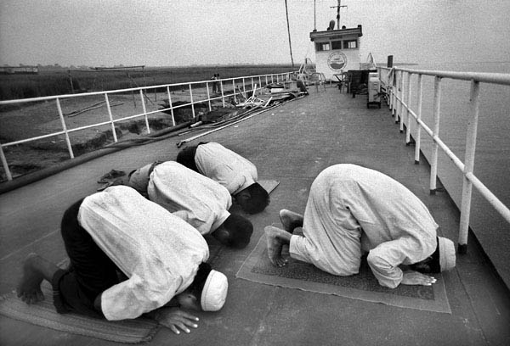
Praying
Praying towards Mecca

Slide 4
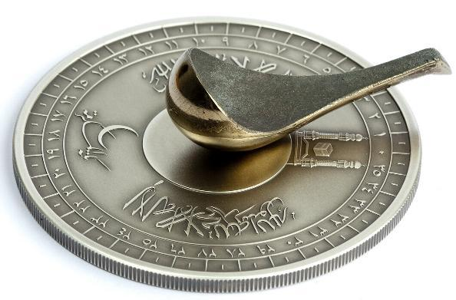
Praying
Must face towards Mecca
Pray five times a day
Sin if not prayed in correct direction

Slide 5
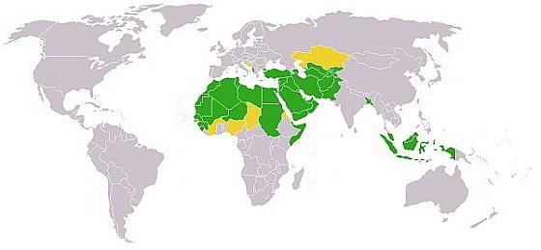
Demographics

Slide 6

Sunni
Largest Sect of Islam
70 to 90 percent of all Muslims
History links them to land

Slide 7
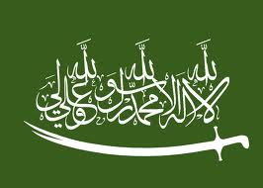
Shia
Second Islamic sect to exist
Heavy influence in Iran and Iraq
Conflict with Sunni sect over place

Slide 8
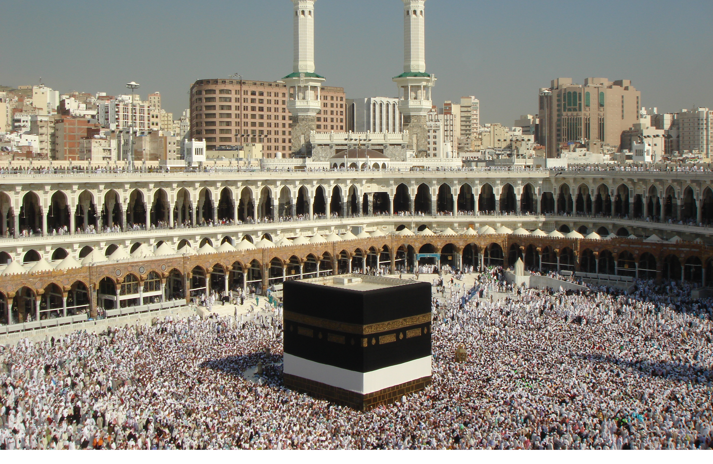
Mecca

Slide 9
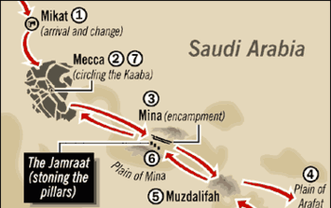
Sa’i

Slide 10
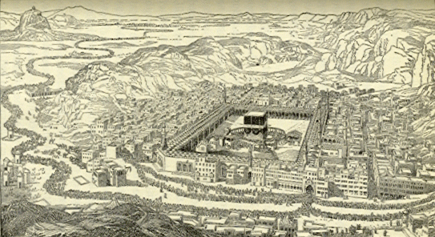
Nostalgia

Slide 11
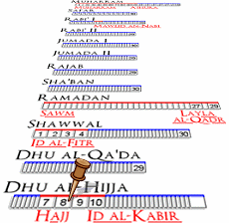
Time Based
Hajj begins on the twelfth month
Second day- Arafah
Mina- Throw stones at a pillar

Slide 12
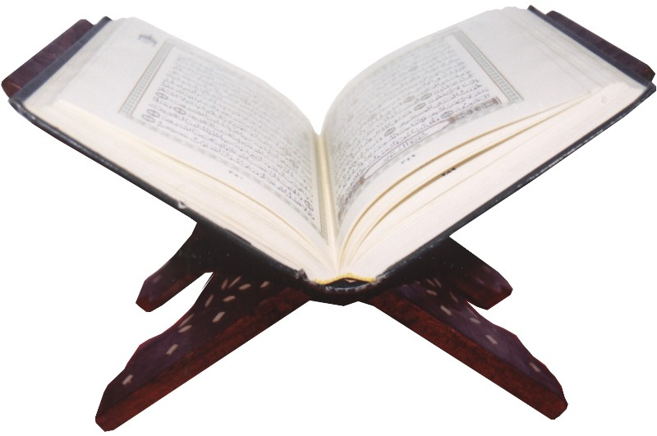
Importance
Preserves disciplines an rituals
Prayer and pilgrimage prevent free thought
Bystander effect on one geographical area

Slide 13
Locked in Mecca
Blaine Killen

